Slide 1
Q4 and Full Year 2024 Presentation
White Pearl Technology Group AB
3 February 2025
Marco Marangoni Chief Executive Officer | Stephen Thorne Chief Solutions Architect | Chettan Ottam Chief Financial Officer

Slide 3
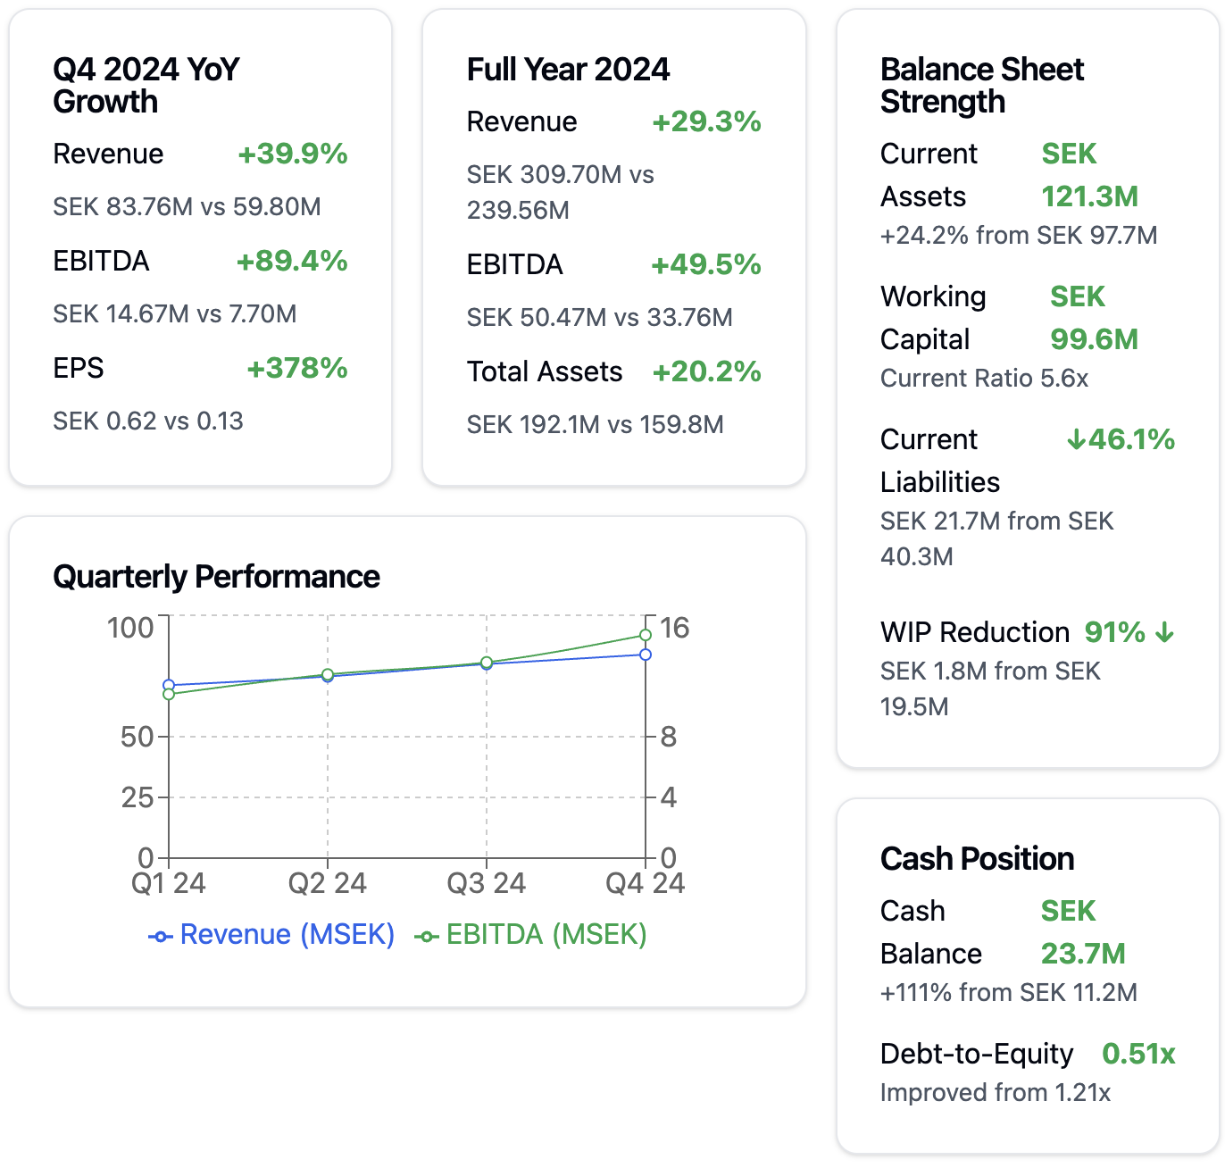
Chettan Ottam CFO

Slide 4
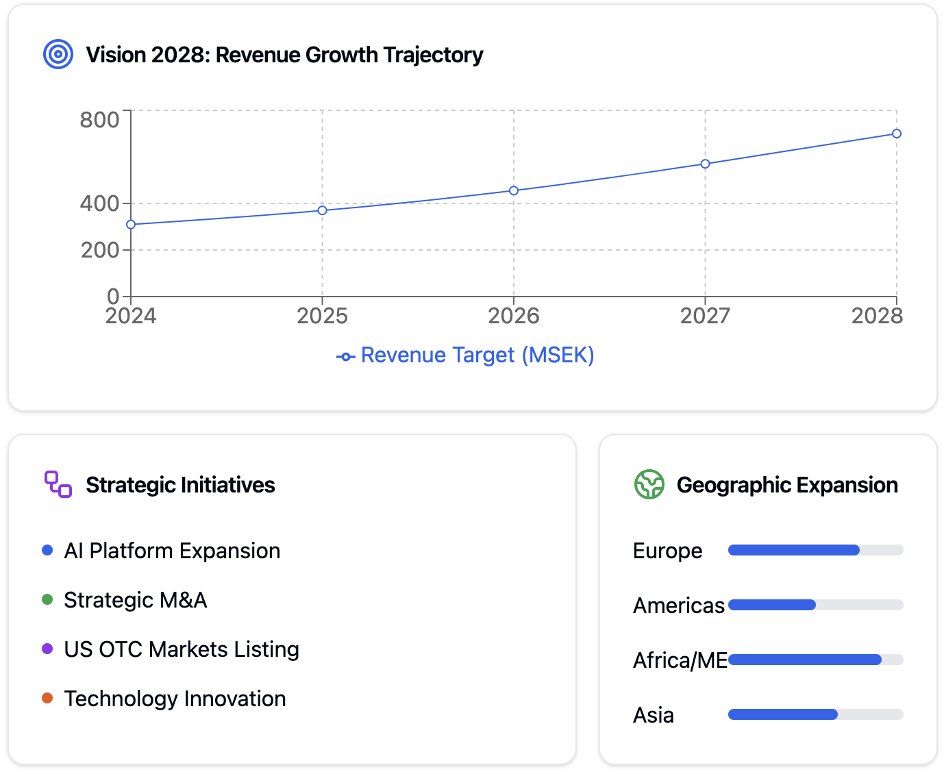
Marco Marangoni CEO

Slide 5
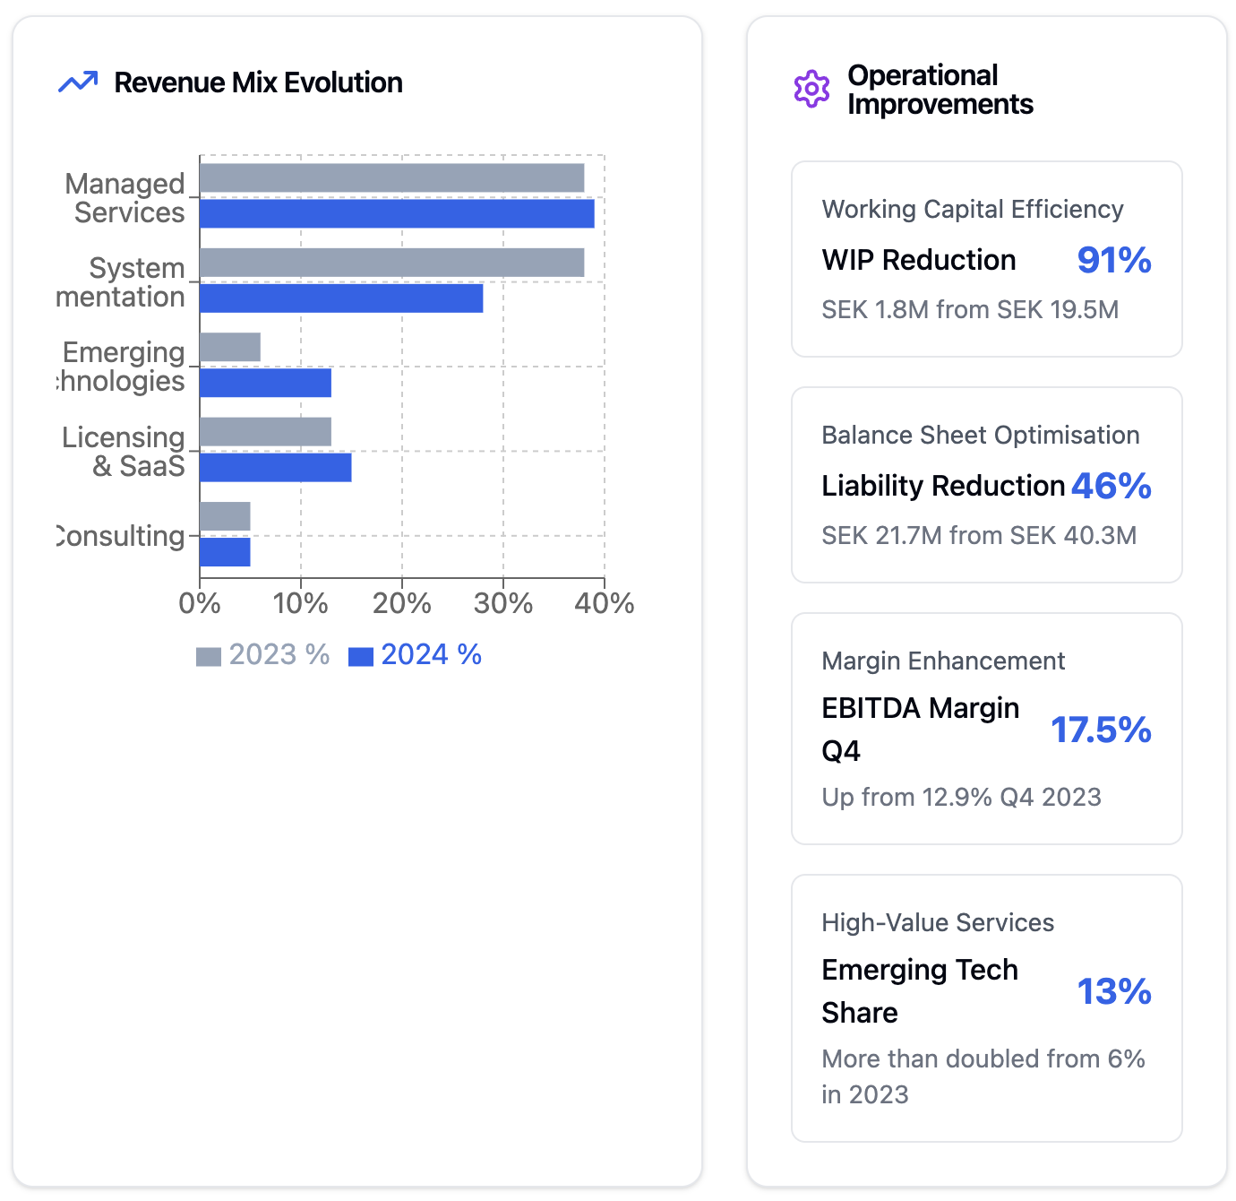
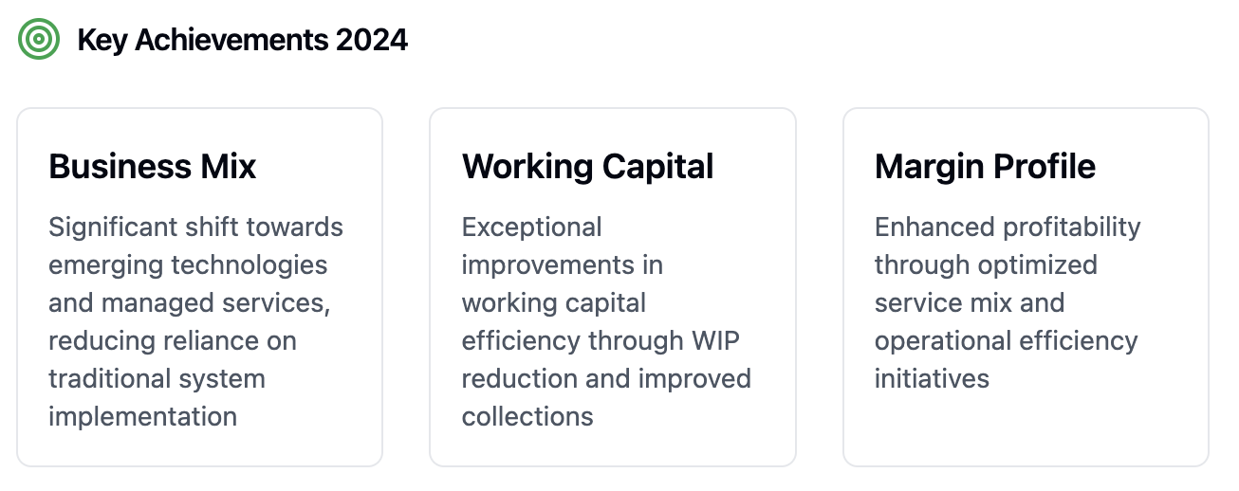
Stephen Thorne
Chief Solutions Architect

